Slide 1
Traffic Safety in Los Angeles
Saul E Villarreal, Corinna Fabre, Veasna Oum, Jenn Dandrea
Presenting to the Department of Transportation for the city of Los Angeles September 10, 2019

Slide 2
25%
Increase in collisions between 2010 and 2019

Slide 3
$9,300,000,000
How much traffic costs the city of Los Angeles per year

Slide 4
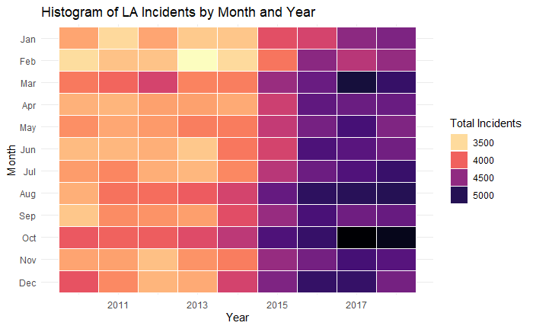
THINGS ARE GETTING BAD

Slide 5
SO, HOW DO WE CUT THAT DOWN?

Slide 6
THE DATA BREAKDOWN
Personal demographics
Location details
Date and time
Notes:
2009-2019 dataset
Cleaning
Age anomalies

Slide 7
KEY ANALYSIS
So, here’s what we found

Slide 8
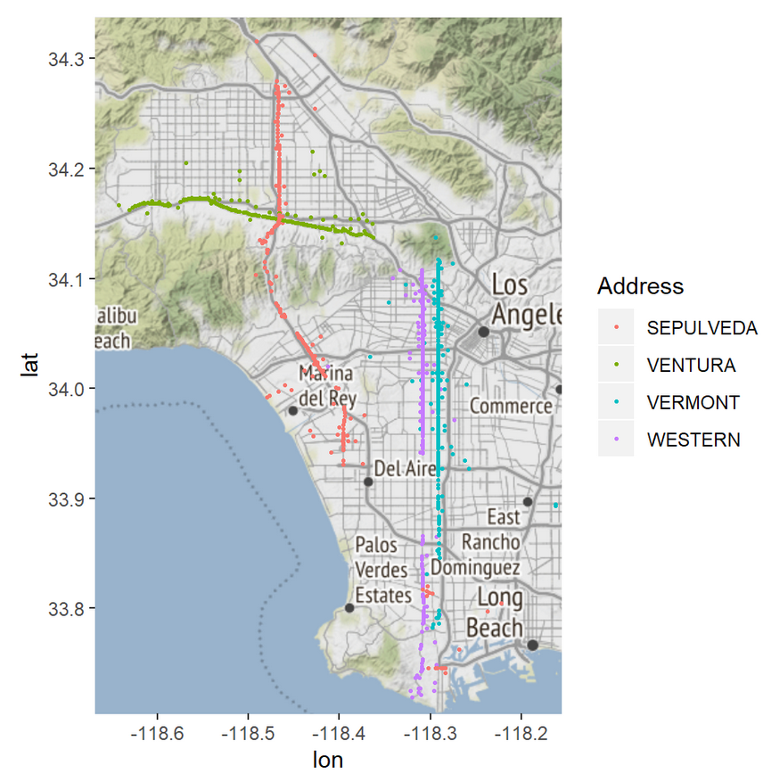
THERE ARE FOUR STREETS CAUSING MAJOR PROBLEMS

Slide 9
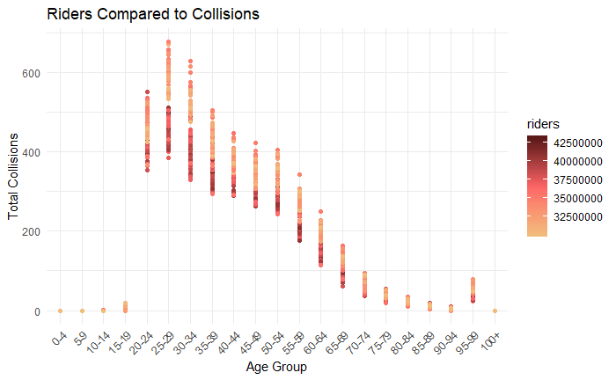
PUBLIC TRANSPORTATION RIDERSHIP IS SIGNIFICANTLY CORRELATED

Slide 10
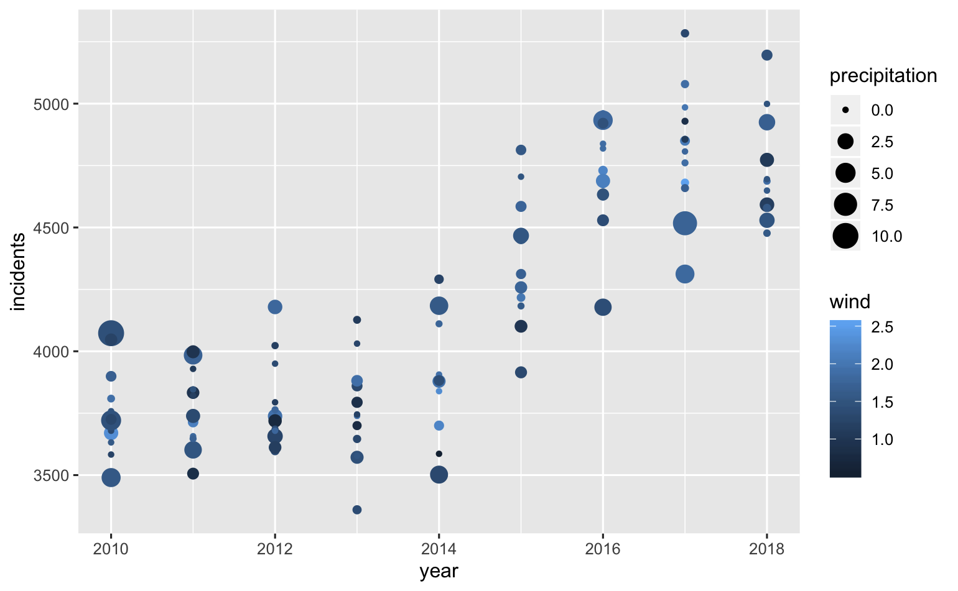
WEATHER CHANGES SHOWED VARYING DEGREES OF SIGNIFICANCE

Slide 11
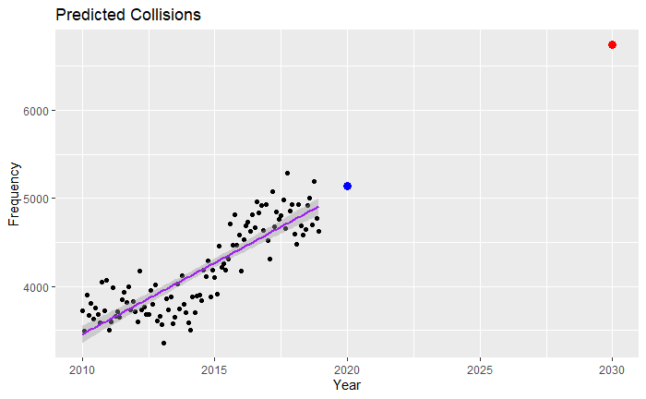
PREDICTIVE ANALYSIS SHOWS RAPID SUSTAINED INCREASE

Slide 12
RECOMMENDATIONS
Here’s what to focus on

Slide 13
Public Transportation
To increase ridership numbers we suggest increasing bus frequency and lowering the price of rail tickets. Other facets:
Partner with local businesses to offer reduced rates to employees
Partner with local business to establish alternative work schedules or work from home opportunities
Focus on drivers ages 20-34
Alternate side of street parking to allow for more buses
Additional Monitoring
In neighborhoods of major concern, increase traffic regulators such as red light cameras, left-turn arrows, higher-visibility crosswalks, speed signs, etc.
Reinstate traffic officers who have been transferred
Revisit state law prohibiting the use of speed radars
Reinvest profits from recent tax increase to overhaul streets

Slide 14
QUESTIONS?

